Slide 1

Examining the Exam: Some Basic Principles of Good Assessment and the Refinement of Multiple-Choice Questions for Use on Tests
Monday, January 8, 2018 Kirtland Community College

Slide 2
Introduction
The construction of a good assessment does not rest upon one, or several elements, but upon the attention to the detail of numerous elements. Today we will focus on elements that may be seemingly unrelated on their own, but which combine to produce useful test scores and test score interpretations.
We have chosen to direct emphasis today on multiple-choice questions as this is an area in which a test developer can apply hands-on principles and analyses to augment test fidelity.

Slide 3
Overview
Foundations and considerations for good assessments
Rules of good form for multiple-choice questions (MCQs)
Writing items to different cognitive levels
Employing psychometric analyses to evaluate and refine MCQs
Test security

Slide 4
Foundations and Considerations of Good Assessments

Slide 5
Validity
The degree to which accumulated evidence and theory support a specific interpretation of test scores for a given use of a test. If multiple interpretations of a test score for different uses are intended, validity evidence for each interpretation is needed.
Validation is the process through which the validity of a proposed interpretation of test scores for their intended uses is investigated. AREA, APA, NCME: P. 225.
Does the test measure what it intends to measure?

Slide 6
Sample types of evidence to support a validity argument
Content-related validity
Criterion-related validity
Construct validity

Slide 7
Reliability
The degree to which test scores for a group of test takers are consistent over repeated applications of a measurement procedure and hence are inferred to be dependable and consistent for an individual test taker; the degree to which scores are free from random errors of measurement for a given group. AREA, APA, NCME: P. 222-223
Does the test measure consistently?

Slide 8
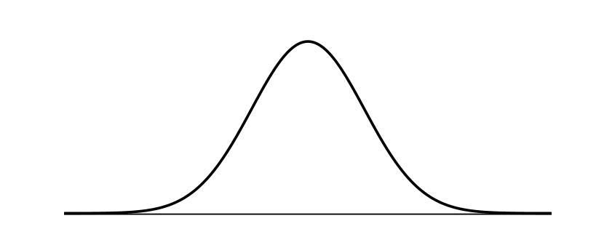
Types of Test Score Interpretations
Norm-referenced
Criterion-referenced
Examinee performance is interpreted by comparing it to the performance of a group.
Examinee performance is interpreted by comparing it to an independent standard (or criterion).
Typically based on systematically-gathered judgements.

Slide 9
Significance of the passing point (cut-score)
Is performance compared to other examinees or to an external standard?
Classroom assessments frequently compare the performance of students within a class
Credentialing assessments frequently compare the performance of examinees to a standard

Slide 10
Types of Items and Approaches Used in Assessments
True-false
Fill in the blank
Short-answer
Essay
Multiple-choice
Interviews
Practical tests of performance

Slide 11
Multiple-choice items
Why are multiple-choice items so widely used?
Advantages
Disadvantages
A-type, S-type, K-type items

Slide 12
Structure of an MCQ
What is the capital city of Scotland? stem
distractor A) Glasgow
key B) Edinburgh options
distractor C) Aberdeen
distractor D) Inverness

Slide 13
Rules of Good Form for Multiple-Choice Questions (MCQs)

Slide 14
Multiple-choice items: Rules of good form for structure and content
General Item Guidelines
1. Assess only one skill or knowledge area in a single question. Test items should be based on a single concept, objective, idea, or procedure.
The planet nearest the Sun is
A) Venus.
B) Earth.
C) Neptune.
D) Mercury.

Slide 15
Multiple-choice items: Rules of good form for structure and content
2. Ensure that the content of the item closely matches the objective, task, or knowledge to be tested.
Objective: Adjust camera settings to achieve desired Depth of Field for image focus.
A narrow Depth of Field can be best achieved by employing a
A) high ISO setting.
B) small f-stop setting.
C) time-delay shutter release.
D) shutter speed of 1/1000 second.

Slide 16
Multiple-choice items: Rules of good form for structure and content
3. Avoid measuring knowledge extraneous to that which the item is written to measure.
Use terminology and structure commensurate with learning level.
Avoid measuring reading comprehension (unless it is a reading comprehension test).

Slide 17
Multiple-choice items: Rules of good form for structure and content
4. Avoid the use of "trick" items, or items measuring insignificant points.
The planet most distant from the Sun is
A) Venus.
B) Pluto.
C) Neptune.
D) Mercury.

Slide 18
Multiple-choice items: Rules of good form for structure and content
5. Construct all test items with adherence to the standard rules of punctuation, capitalization, and grammar. Avoid grammatical clues to the answer.
Prior to performing venipuncture, the phlebotomist
A) must confirm the patient’s identity.
B) she should determine which test will be performed by the laboratory.
C) a supervisor must be present during the procedure.
D) The “sharps” container must be empty.

Slide 19
Multiple-choice items: Rules of good form for structure and content
6. Ensure that the item requires content knowledge to arrive at the correct answer rather than simple logic or common sense alone.
The branch of biology that studies the animal kingdom is also known as
A) zoology.
B) etiology.
C) etymology.
D) ornithology.

Slide 20
Multiple-choice items: Rules of good form for structure and content
7. Avoid the use of vague terms such as: "frequently", “often", "sometimes", "typically", “generally”, "may", "usually", etc.
Which of the following will generally result in a blurry radiographic image?
A) Patient movement
B) Poor operator training
C) Digital imaging methods
D) Malfunctioning equipment

Slide 21
Multiple-choice items: Rules of good form for structure and content
8. In general, avoid the use of abbreviations unless they are common in the relevant practice.
The change from MSDS to SDS is associated with which one of the following?
A) GHS
B) CMS
C) TJC
D) HFAP
Globally Harmonized System of Classification and Labeling of Chemicals (GHS)

Slide 22
Multiple-choice items: Rules of good form for structure and content
9. Ensure that within any group of items, the correct answer follows a random pattern.
Question Sequence | Key
12 | B
13 | C
14 | A
15 | B
16 | A
17 | D

Slide 23
Multiple-choice items: Rules of good form for structure and content
10. Ensure that within any group of items, the correct answer to an item is not found in the stem of another item.
Neptune, the planet most distant from the sun, is also known as the
A) largest planet.
B) windiest planet.
C) planet with the greatest mass.
D) planet with the most temperature extremes.

Slide 24
Multiple-choice items: Rules of good form for structure and content
11. Every item should be accompanied by a reference to an authoritative source that unambiguously validates the answer key.
In addition to the land lying immediately north of England, the country of Scotland also includes the
A) county of Antrim.
B) Isles of Scilly.
C) Isle of Man.
D) Hebrides.
Mackay, J. (Ed.). (2014). Pocket Scottish History: Story of a Nation. Broxburn, Scotland: Lomond Books, Ltd. (p.6.)

Slide 25
Multiple-choice items: Rules of good form for structure and content
Item Stem Guidelines
12. Ensure that the item stem clearly defines a single problem.
Test items should be based on a single concept, objective, idea, or procedure. Should an examinee answer a item with complex construction incorrectly, it will be unclear to the instructor which concepts were missed.
Complex procedures can be assessed with a battery of test items.

Slide 26
Multiple-choice items: Rules of good form for structure and content
Item Stem Guidelines
13. Ensure that the item stem is free of all irrelevant material.
Psychometricians can occasionally be in disagreement over how best to approach a measurement issue. However, most would likely agree that one way of increasing test reliability would be to
A) increase test length.
B) increase the number of item distractors.
C) perform a check for differential item
functioning (DIF).
D) subject the test results to an IRT-based
method of analysis.

Slide 27
Multiple-choice items: Rules of good form for structure and content
Item Stem Guidelines
14. Ensure that the item stem is free of grammatical and semantic clues to the correct answer.
In music theory, the Circle of Fifths is related to the
A) violins.
B) pianos have 88 keys.
C) orchestras seat musicians in groups of five, in a circle configuration.
D) relationship among the 12 tones of the chromatic scale.

Slide 28
Multiple-choice items: Rules of good form for structure and content
Item Stem Guidelines
15. Avoid the use of negative words when possible ("not", "except", "incorrect", etc.). Underline, bold, or highlight negative words when their use is necessary.
Which one of the following is NOT a test security concern?
A) Examinee identity
B) Examinee collusion
C) Test item exposure and item bank size
D) Publication of test content outline

Slide 29
Multiple-choice items: Rules of good form for structure and content
Item Stem Guidelines
16. Avoid the use of double negatives.
Which one of the following practices is NOT inappropriate when performing venipuncture?
A) Asking patient’s date of birth
B) Use of a non-sterile collection device
C) Not releasing the tourniquet after five minutes
D) Employing reverse order of draw

Slide 30
Multiple-choice items: Rules of good form for structure and content
Response Option Guidelines (“Options” include all distractors and the keyed response)
17. Avoid overlapping answer options.
The normal respiration rate for an adult at rest is _______ breaths per minute.
A) 12 to 20
B) 13 to 19
C) 10 to 20
D) 22 to 26
(Adults, 16-20 breaths per minute: Medscape.com)

Slide 31
Multiple-choice items: Rules of good form for structure and content
Response Option Guidelines (“Options” include all distractors and the keyed response)
18. Include only one clearly correct answer in the options.
A blurry radiographic image can be the result of
A) patient movement.
B) poor operator training.
C) malfunctioning equipment.
D) the use of digital imaging
methods.

Slide 32
Multiple-choice items: Rules of good form for structure and content
Response Option Guidelines (“Options” include all distractors and the keyed response)
19. Ensure that all options are free of irrelevant material.
The planet nearest the Sun is
A) the red planet, Mars.
B) Earth’s sister planet, Venus.
C) the windiest planet, Neptune.
D) second-hottest planet, Mercury.

Slide 33
Multiple-choice items: Rules of good form for structure and content
Response Option Guidelines (“Options” include all distractors and the keyed response)
20. Remove all repetitive words from the options and include them in the stem.
A child reporting tooth pain
A) should be taken to a dentist.
B) should be taken to a physician.
C) should be taken to an
ophthalmologist.
D) should be taken to a
otolaryngologist.

Slide 34
Multiple-choice items: Rules of good form for structure and content
Response Option Guidelines (“Options” include all distractors and the keyed response)
21. Ensure that all options are grammatically and semantically compatible with the item stem.
Test validity can be improved by
A) increasing test length.
B) ensuring that test content
addresses measurable
objectives.
C) Examinations should minimize
bias.
D) shorter tests are generally more
valid than longer tests.

Slide 35
Multiple-choice items: Rules of good form for structure and content
Response Option Guidelines (“Options” include all distractors and the keyed response)
22. Ensure that all options are as homogeneous as possible. Use parallel and plausible answer options.
Which of the following is a team in Major League Soccer (MLS)?
A) Detroit Lions
B) Chicago Cubs
C) Columbus Crew SC
D) National Football League

Slide 36
Multiple-choice items: Rules of good form for structure and content
Response Option Guidelines (“Options” include all distractors and the keyed response)
23. Construct all options so that they are approximately the same length.
When a practitioner is asked to perform a task prohibited by law, the practitioner should
A) perform the task.
B) refuse to perform the task.
C) assess the degree of potential harm
caused by performing the task.
D) approach the supervisor, describe the
situation, indicate the necessity to
observe the law, then escalate the report
to administration if the response from the
supervisor is to perform the task.

Slide 37
Multiple-choice items: Rules of good form for structure and content
Response Option Guidelines (“Options” include all distractors and the keyed response)
24. Construct all distractors so that they are incorrect, but plausible.
Avoid the use of options that don’t really exist.
Which of the following mammals is indigenous to North America?
A) Macaque
B) Watermelon
C) Oligosoma homalonotum
D) Franklin’s ground squirrel
B) Yellow-billed varmint

Slide 38
Multiple-choice items: Rules of good form for structure and content
Response Option Guidelines (“Options” include all distractors and the keyed response)
25. Avoid the use of distractors that mean the same thing or the opposite.
Decreasing the Depth of Field in a photographic image can be achieved by using a
A) small aperture.
B) large aperture.
C) high ISO setting.
D) tripod to steady the camera.

Slide 39
Multiple-choice items: Rules of good form for structure and content
Response Option Guidelines (“Options” include all distractors and the keyed response)
26. Avoid the use of similar- sounding words that suggest associations between the stem and the correct answer.
Which one of the following techniques of analysis makes inferences about populations using data drawn from the population?
A) Calculus
B) Geometry
C) Inferential statistics
D) Differential equations

Slide 40
Multiple-choice items: Rules of good form for structure and content
Response Option Guidelines (“Options” include all distractors and the keyed response)
27. Underline, bold, or otherwise emphasize all negative words.
In information technology (IT) support, a “general protection fault”
A) is not associated with a PC-based environment.
B) can be traced to display malfunction.
C) is reported as a malfunction by the operating system.
D) cannot be related to an application error.

Slide 41
Multiple-choice items: Rules of good form for structure and content
Response Option Guidelines (“Options” include all distractors and the keyed response)
28. Avoid the use of negative words in the options if negative words are used in the stem.
Which one of the following practices is NOT appropriate when performing venipuncture?
A) Asking patient’s date of birth
B) Use of a non-sterile collection device
C) Releasing the tourniquet after one minute
D) Consulting departmental procedure for order of draw

Slide 42
Multiple-choice items: Rules of good form for structure and content
Response Option Guidelines (“Options” include all distractors and the keyed response)
29. Avoid the use of "none of the above" or "all of the above" as options.
What is the largest state in the United States in terms of land area?
A) Florida
B) Alabama
C) Wyoming
D) None of the above

Slide 43
Multiple-choice items: Rules of good form for structure and content
Response Option Guidelines (“Options” include all distractors and the keyed response)
30. List options using numeric data in ascending or descending order.
A yard stick is how many inches in length?
A) 42”
B) 36”
C) 28”
D) 12”

Slide 44
Multiple-choice items: Rules of good form for structure and content
Response Option Guidelines (“Options” include all distractors and the keyed response)
31. List options using lettered designations in alphabetical order, if possible.
Which Medicare coverage plan is also known as the “Stand-alone Prescription Drug Plan?”
A) Part A
B) Part B
C) Part C
D) Part D

Slide 45
Multiple-choice items: Rules of good form for structure and content
32. Generally avoid the use of acronyms and jargon. Use acronyms only if they are universally known in a domain or if they are better known than the terms they replace.
The producer in a sound recording studio asks a musician to connect a B3 to the recording buss via MIDI, for input into a DA-88. The musician’s instrument has no USB-out, but does support line out. How should the musician respond to the request?
A) C)
B) D)

Slide 46
Multiple-choice items: Rules of good form for structure and content
OTHER CONSIDERATIONS
Use common student errors as distractors
Avoid the use of humor
Avoid items based on opinions
Emphasize higher-level thinking
Avoid complex multiple-choice items
Avoid testing overly-specific knowledge or “picky” points

Slide 47
Multiple-choice items: Rules of good form for structure and content
OTHER CONSIDERATIONS
Avoid regional expressions and colloquialisms
Avoid the use of biased test items (gender, age, culture, etc.)
Avoid unfocused item stems
Ensure that test content is current
Minimize time it takes for examinees to read content
Items phrased as questions are preferable to the sentence-completion format
Items should typically be answerable by reading the stem alone (obscuring options)

Slide 48
Writing Test Items To Different Cognitive Levels
(Bloom’s Taxonomy)

Slide 49
Bloom’s Taxonomy: Original and Revised
Bloom Anderson-Krathwohl Revision
Knowledge Remembering
Comprehension Understanding
Application Applying
Analysis Analyzing
Synthesis Evaluating
Evaluation Creating
Anderson, L. W. and Krathwohl, D. R., et al (Eds..) (2001) A Taxonomy for Learning, Teaching, and Assessing: A
Revision of Bloom’s Taxonomy of Educational Objectives. Allyn & Bacon. Boston, MA (Pearson Education Group)
Taxonomy of Educational Objectives. (1956). Bloom, B. S., Ed. New York: David McKay Company.

Slide 50
Bloom’s Taxonomy: Key Words for Objectives, Assignments, and Evaluations
Level Sample Key Words
Remembering define, describe, name, recall, recognize, select
Understanding associate, distinguish, compare, illustrate, paraphrase
Applying compute, demonstrate, estimate, illustrate, interpret, solve
Analyzing compare, determine, categorize, outline, distinguish
Evaluating evaluate, judge, rank, detect, monitor, test, validate
Creating generate, hypothesize, design, plan, produce, construct

Slide 51
Cognitive Levels Employed as Item Descriptors
Cognitive Level |  | Description of Ability
Level 1: Recall of Facts |  | This level refers to the ability to recall or recognize previously learned information. The range of abilities in this level may involve the recall of particular facts to the recall of theories.
Level 2: Interpretation and Application |  | This level refers to the ability to apply recalled knowledge to interpret presented information. This process may involve knowing relationships among facts and principles.
Level 3: Problem Solving, Judgement, and Evaluation |  | This level refers to the ability to use recalled knowledge to interpret (or to apply it to) presented information in the process of solving a problem. Situations may be analyzed and evaluated, and decisions may be required based on facts or principles. Problem solving and decision making are emphasized.

Slide 52
Employing Psychometric Analyses to Evaluate and Refine MCQs
Classical Test Theory – Selected Indices

Slide 53
Classical Test Theory Indices (Selected)
Item Difficulty (p-value as reflected by percent correct)
Item Discrimination (r-value as reflected by point-biserial correlation)
Test Reliability (as reflected by Cronbach’s Alpha)
Option analysis

Slide 54
Comma-Separated Values (CSV) File
question ID
question title
answered student count
top student count (top 27%)
middle student count (middle 46%)
bottom student count (bottom 27%)
quiz question count (total number of questions on test)
correct student count (number of students answering correctly)
wrong student count (number of students answering incorrectly)
correct student ratio (ratio of students answering correctly)
wrong student ratio (ratio of students answering incorrectly)
correct top student count (students in the top 27% answering correctly)
correct middle student count (students in the middle 46% answering correctly)
correct bottom student count (students in the bottom 27% answering correctly)
variance (of scores on this item)
standard deviation (of scores on this item)
difficulty index
Alpha index (for entire test)
point-biserial for the correct answer
point-biserial for the first incorrect answer or distractor (followed by the second, etc.)

Slide 55
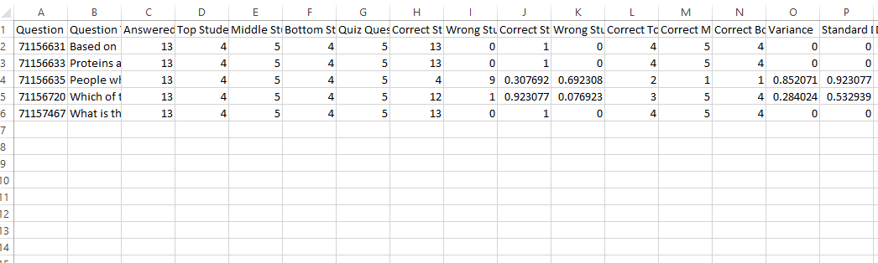
Opening a CSV File in a Spreadsheet to View Data

Slide 56
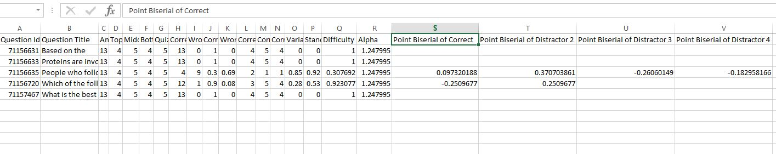
difficulty index
Alpha index (for entire test)
point-biserial for the correct answer
point-biserial for the first incorrect answer or distractor (followed by the second, etc.)

Slide 57
p-value
Index of item difficulty
Proportion of examinees answering the item correctly
Ranges from 0 to 1 (0% to 100%)
A p-value of .67 indicates that the question was answered correctly by 67% of the group
Lower values indicate more difficult questions – higher values indicate easier questions

Slide 58
Interpreting p-value
Difficulty index | Percent Correct | Interpretation
.76 - 1.00 | 76% - 100% | Easy item
.51 - .75 | 51% - 75% | Item of moderate difficulty
.26 - .50 | 26% - 50% | Difficult item
.00 - .25* | 0% - 25% | Very difficult item
* On a four-option multiple-choice question, .25 = chance.

Slide 59
r-value
Index of item discrimination
The degree to which questions differentiate or discriminate between examinees who know the material well and those who do not know the material well.
Represented by the item-total correlation coefficient. A point-biserial correlation addresses the relationship between item scores and the total score on an examination. Higher total scores should reflect higher item scores.
Ranges from -1 to +1
Negative values indicate that examinees who know the material better are answering the question incorrectly.

Slide 60
Interpreting r-value
Discrimination index Interpretation Response
.40 or larger Excellent
.30 - .39 Good
.11 - .29 Fair Review item for improvement
.00 - .10 Poor Review item for improvement
Negative value Item flaw, miskey Remove from assessment if
flawed or correct key and
rescore assessment

Slide 61
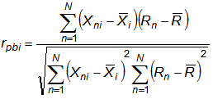
The point-biserial correlation

Slide 62
Alpha (reliability coefficient)
Test Reliability (as reflected by Cronbach’s Alpha)
Cronbach’s alpha is considered to be a measure of scale reliability.
As a measure of internal consistency, it indicates how closely related a set of items are as a group.
Indicates how likely examinee would obtain the same score if examined again.
Ranges from 0 to 1

Slide 63
Interpreting Reliability Coefficient
Reliability Coefficient Interpretation
.90 or larger Excellent for any assessment
.80 - .89 Very good for a classroom test
.70 - .79 Good for a classroom test
.60 - .69 Borderline
.50 - .59 Low
Below .50 Poor reliability

Slide 64
Sample items flagged for review
p-value
r-values (for key and distractors)
Percentage of examinees choosing each option
Relative proportions of examinees choosing each option
Percentage of examinees not answering a question
Size of analysis group (total N)

Slide 65
Clinical laboratory safety regulations ORIGINATED with
p-val r-val
.15 -.20 A) CDC *
.35 -.07 B) CLIA
.47 .24 C) OSHA
.03 -.09 D) CMS
Difficult item
Non-critical item
Deleted item!

Slide 66
Laboratory results for diagnostic purposes should FIRST
be reported to the
p-val r-val
.03 -.02 A) patient.
.94 -.08 B) provider. *
. 0 . 0 C) receptionist.
.03 .13 D) medical records department.
Very easy item
Deleted item

Slide 67
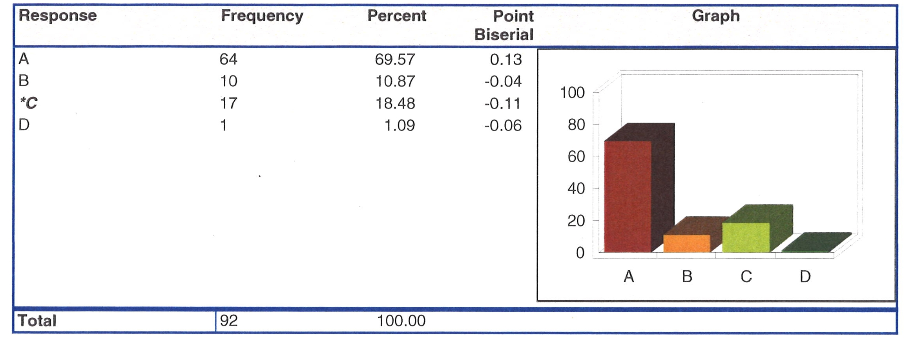
Test Item: Which of the following signatures is most secure?

Slide 68
Which of the following signatures is most secure?
p-val r-val
.70 .13 A) Written
.11 -.04 B) Stamped
.18 -.11 C) Electronic *
.01 -.06 D) Photocopied

Slide 69
Blood drawn using the syringe method is placed into
which one of the following collection tubes FIRST?
p-val r-val Mean Raw Score
.53 -.34 A) Non-additive * 140
.15 .18 B) EDTA 155
.00 .00 C) Heparin
.32 .22 D) Sodium citrate 153
Flawed item
Deleted item

Slide 70
When performing a bleeding time the blood pressure cuff
should be inflated and maintained at
p-val r-val Mean Raw Score
.23 -.21 A) 30 mm Hg. 138
.35 .04 B) 40 mm Hg. * 148
.24 .13 C) 60 mm Hg. 151
.18 .03 D) 80 mm Hg. 147
Guessing prevalent
Obsolete item
Deleted item!

Slide 71
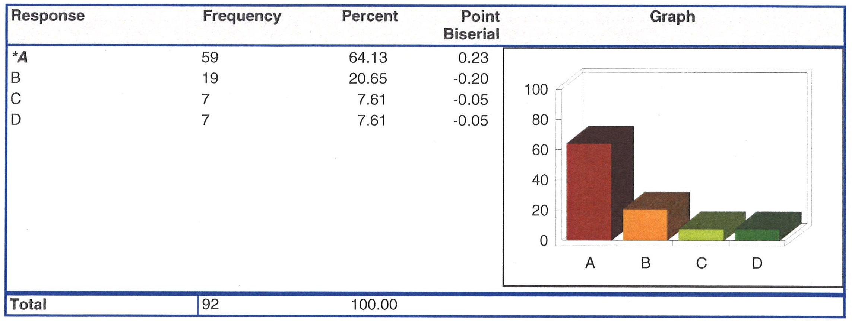
Acceptable item statistics

Slide 72
The importance of test security as an aspect of the validity argument

Slide 73
The importance of test security in the validity argument and in the protection of intellectual property
An assessment may be located on a continuum that ranges from “low stakes” to “high stakes” tests. A primary factor in the classification rests with the uses and consequences of test results. The level of security applied to test administration must be commensurate with the “stakes” of the test.
Licensure/Certification Higher Stakes
Academic placement
Employment decisions
Academic coursework
Home study
Practice tests
Surveys Lower Stakes

Slide 74
Security considerations
Monitored versus unmonitored assessment
Mode of administration (computer, paper-and-pencil)
Environment control considerations (ID checks, prohibited devices, allowance of breaks, video recording of test administration sessions, biometrics, etc.)
Considerations related to the protection of intellectual property (IP)
Not only important to ensure that scores are valid for examinees but also important that test content is not exposed beyond the testing room
Security-based test design considerations (item exposure rules, alternate test forms, size of item pools, etc.)

Slide 75
Toward establishing an environment of academic integrity for examinations

Slide 76
Use of “honor codes” in examinee conduct
Statements affirming that as an aspect of an academic experience, a (student, examinee, certification candidate, researcher, professional, etc.) will neither participate in, nor tolerate academic dishonesty.
Elements may include affirmations that I will:
… take the examination in an honest fashion.
… not copy another person’s work and represent it as my own.
… not allow another person to copy my work.
… not employ technology or other aids to cheat.
… treat examinations confidentially.

Slide 77
To conclude: A few things to consider when constructing and using exams
Foundations and considerations of good assessments (validity, reliability, fairness, reference group for score interpretation, etc.)
Rules of good form for multiple-choice questions (MCQs) to reinforce content validity argument
Writing items to represent appropriate cognitive levels
Employing psychometric analyses to evaluate and refine MCQs
Test security
Promoting an environment of academic integrity for test taking

Slide 78
Questions and further discussion

